Slide 1

Pattern Classification
All materials in these slides were taken from
Pattern Classification (2nd ed) by R. O. Duda, P. E. Hart and D. G. Stork, John Wiley & Sons, 2000 with the permission of the authors and the publisher

Slide 2

Chapter 4 (part 2):
Non-Parametric Classification (Sections 4.4-4.5)
Kn –Nearest Neighbor Estimation
The Nearest-Neighbor Rule

Slide 3
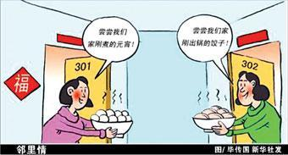
4.4 K_{n} - Nearest neighbor estimation
Goal: a solution for the problem of the unknown “best” window function
    Let the cell volume be a function of the training data (k_{n})
    Center a cell about x and let it grow until it captures k_{n} samples
    (k_{n} = f(n))
    k_{n} are called the k_{n} nearest-neighbors of x
Pattern Classification Chapter 4 part 2

Slide 4
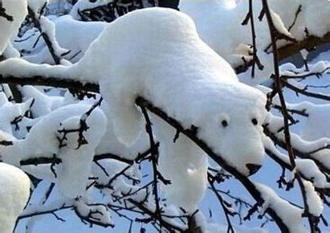
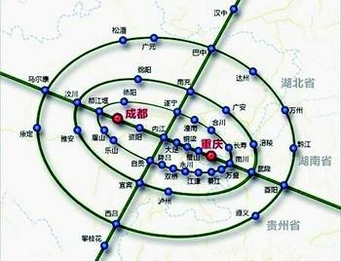
  2 possibilities can occur:
    Density is high near x; therefore the cell will be small which provides a good resolution
    Density is low; therefore the cell will grow large and stop until higher density regions are reached
  We can obtain a family of estimates by setting k_{n}=k₁√n and choosing different values for k₁
Pattern Classification Chapter 4 part 2

Slide 5
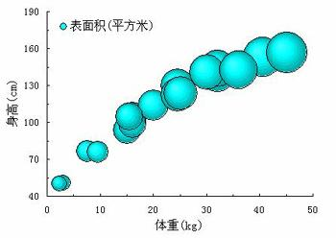
Illustration
  For k_{n} = √n = 1 ; the estimate becomes:
    P_{n}(x) = k_{n} / n/V_{n} = 1 / V₁ =1 / 2|x-x₁|
Pattern Classification Chapter 4 part 2

Slide 6
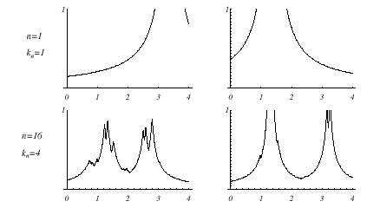
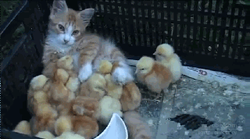
Pattern Classification Chapter 4 part 2

Slide 7
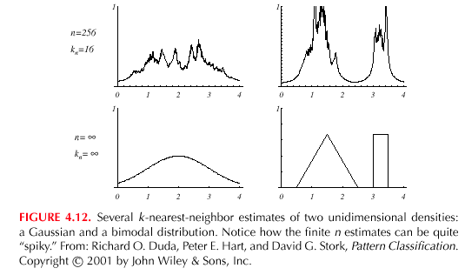


Pattern Classification Chapter 4 part 2

Slide 8

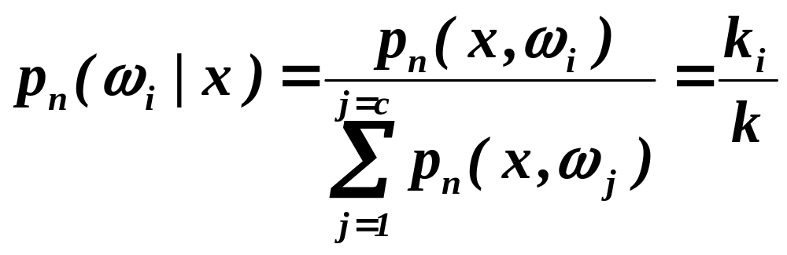
Estimation of a-posteriori probabilities
  Goal: estimate P(ω_{i} | x) from a set of n labeled samples
    Let’s place a cell of volume V around x and capture k samples
    k_{i} samples amongst k turned out to be labeled by ω_{i} then:
    p_{n}(x, ω_{i}) = k_{i} /(nV)
      An estimate for p_{n}(ω_{i}| x) is:
Pattern Classification Chapter 4 part 2

Slide 9
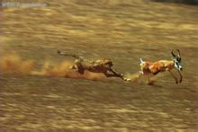

    k_{i}/k is the fraction of the samples within the cell that are labeled as ω_{i}
    For minimum error rate, the most frequently represented category within the cell is selected
    If k is large and the cell sufficiently small, the performance will approach the best value.
Pattern Classification Chapter 4 part 2

Slide 10
4.5 The Nearest-Neighbor Rule
The nearest –neighbor rule
  Let D_{n} = {x₁, x₂, …, x_{n}} be a set of n labeled prototypes
  Let x’ ∈ D_{n} be the closest prototype to a test point x then the nearest-neighbor rule for classifying x is to assign it the label associated with x’
  The nearest-neighbor rule leads to an error rate greater than the minimum possible value of the Bayes rate
  If the number of prototypes is large (unlimited), the error rate of the nearest-neighbor classifier is never worse than twice the Bayes rate (it can be demonstrated!)
  If n → ∞, it is always possible to find x’ sufficiently close so that:
  P(ω_{i} | x’) ≅ P(ω_{i} | x)
Pattern Classification Chapter 4 part 2

Slide 11
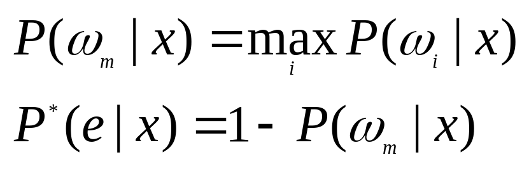
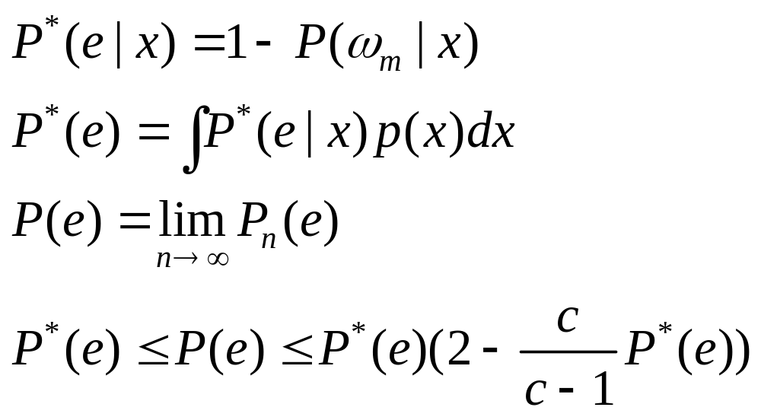

  If P(ω_{m} | x) ≅ 1, then the nearest neighbor selection is almost always the same as the Bayes selection
  Convergence of the Nearest Neighbor
Pattern Classification Chapter 4 part 2

Slide 12
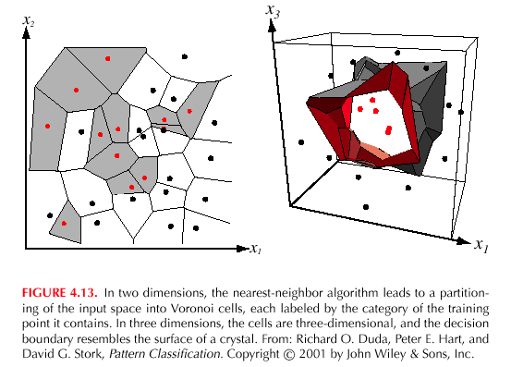
Pattern Classification Chapter 4 part 2

Slide 13

The k – nearest-neighbor rule
    Goal: Classify x by assigning it the label most frequently represented among the k nearest samples and use a voting scheme
Pattern Classification Chapter 4 part 2

Slide 14
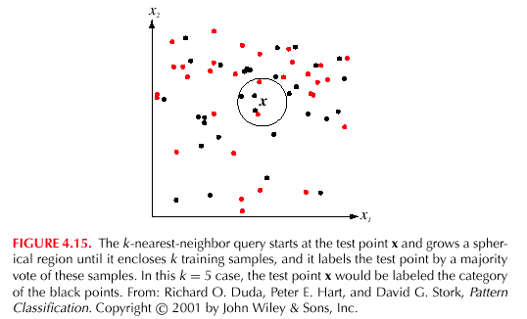
Pattern Classification Chapter 4 part 2

Slide 15

Example:
k = 3 (odd value) and x = (0.10, 0.25)^{t}
Closest vectors to x with their labels are:
{(0.10, 0.28, ω₂); (0.12, 0.20, ω₂); (0.15, 0.35,ω₁)}
One voting scheme assigns the label ω₂ to x since ω₂ is the most frequently represented
Prototypes | Labels
(0.15, 0.35) (0.10, 0.28) (0.09, 0.30) (0.12, 0.20) | ω₁ ω₂ ω₅ ω₂
Pattern Classification Chapter 4 part 2

Slide 16
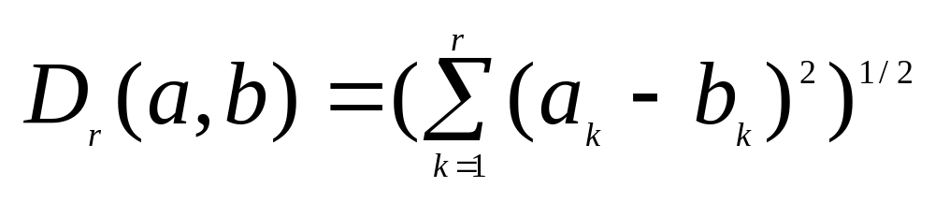
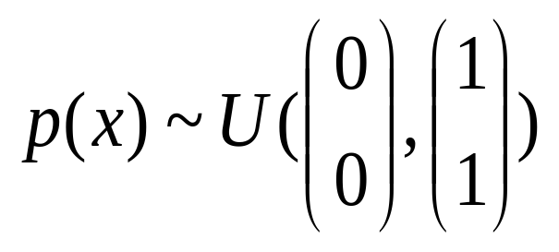
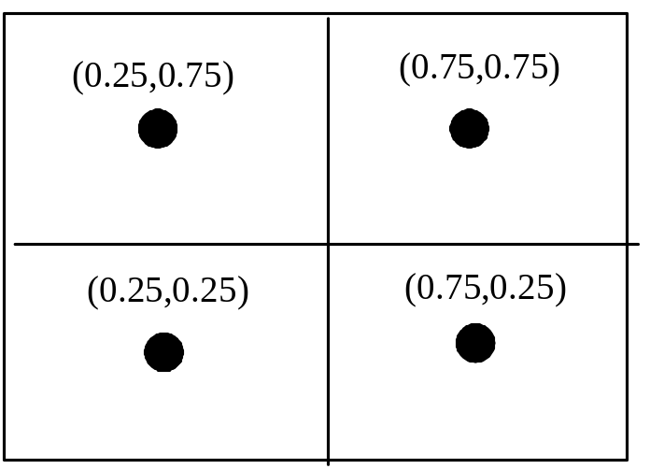
Reducing the computational complex in nearest-neighbor search
  Computing partial distance
  Create some form of search tree, for example
Pattern Classification Chapter 4 part 2

Slide 17
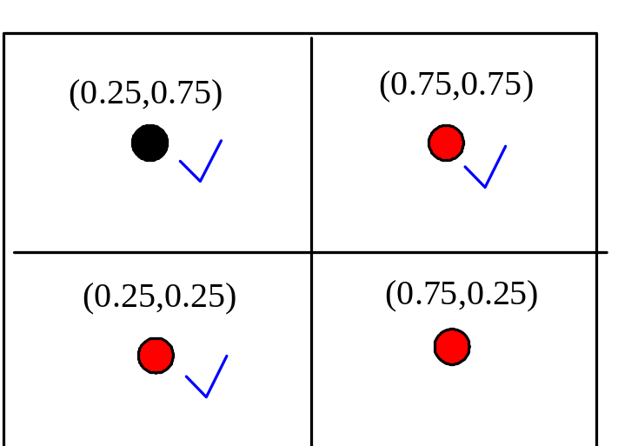
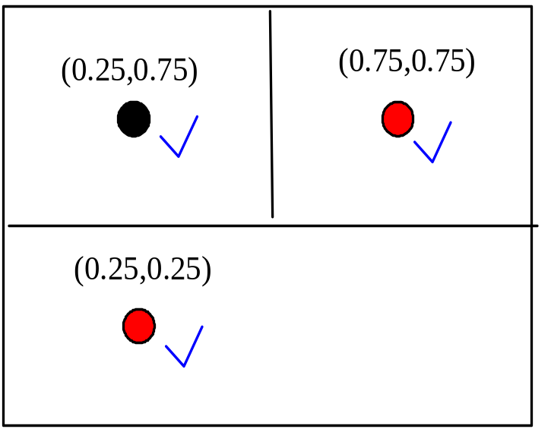

  Nearest-Neighbor Editing
Pattern Classification Chapter 4 part 2

Slide 18
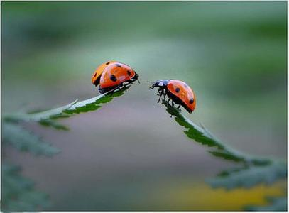
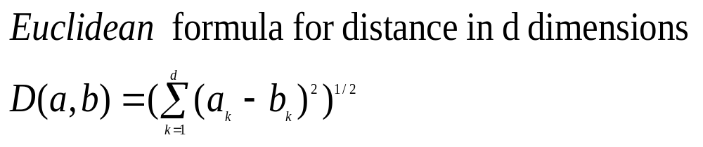
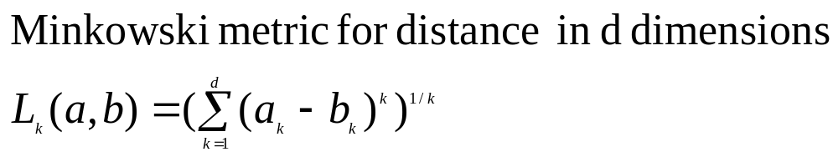
4.6 Metrics
Properties of Metrics
  Nonnegativity:D(a,b)>=0
  Reflexivity:D(a,b)=0 if and only if
  a=b
  Symmetry:D(a,b)=D(b,a)
  Triangle inequality:D(a,b)+D(b,c)>=D(a,c)
Pattern Classification Chapter 4 part 2

